Slide 1


Unit Root Testing
Wake Forest
School of Business
_______

Slide 2
Addressing Stationarity
Trend stationary: stationary after accounting for (or removing) the trend
Difference stationary: the first differences of the series are stationary
Unit root test may help to determine whether the series is trend stationary or difference stationary.
NOTE: Differencing helps to stabilize the mean of a time series by removing changes in the level of a time series, and so minimizing the effect of trend and seasonality. Transformations such as logarithms can help to stabilize the variance of a time series.

Slide 3
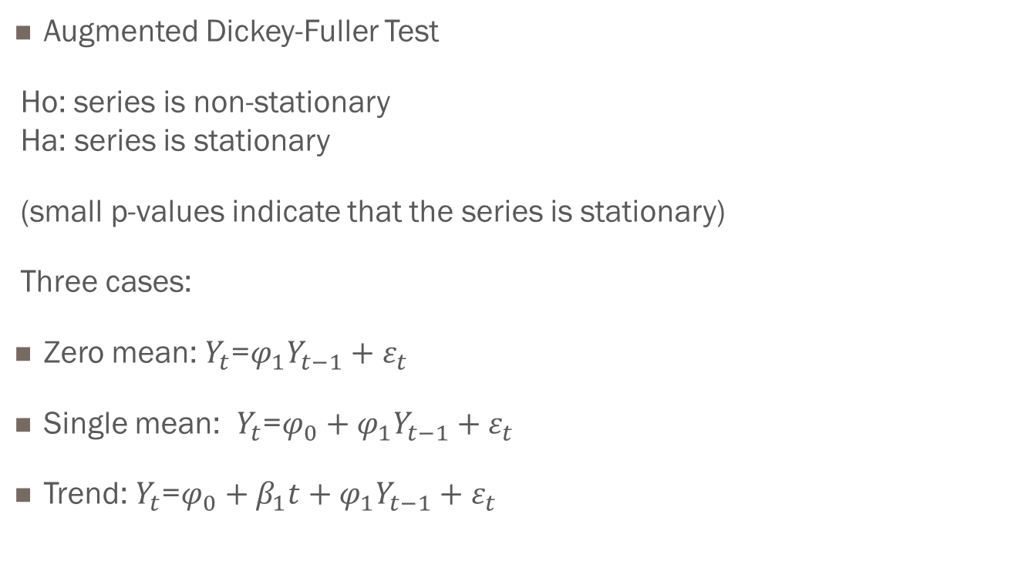
Unit Root Test
Augmented Dickey-Fuller Test
Ho: series is non-stationary Ha: series is stationary
(small p-values indicate that the series is stationary)
Three cases:
Zero mean: $Y_{t}$=$φ_{1}Y_{t−1}+ε_{t}$
Single mean: $Y_{t}$=$φ_{0}+φ_{1}Y_{t−1}+ε_{t}$
Trend: $Y_{t}$=$φ_{0}+β_{1}t+φ_{1}Y_{t−1}+ε_{t}$

Slide 4
Examples
Inventory Series (Stationary)
Sales Series (Difference Stationary)
Hotel Occupancy Series (Trend Stationary)

